Slide 1



Slide 2

Photographers World
Supervised by:
Sir Rehan Tariq
Group Members:
Ammar Baig (FA17-BCS-024)
Madiha Gul (FA17-BCS-082)
Department of Computer Science
COMSATS University Islamabad, Attock Campus

Slide 3
Outline
Introduction
Design
Working flow
Problem statement
Objectives
Methodology
Modern tools
Benefits
Time Line
Data Flow Diagrams
Sequence Diagrams
Activity Diagrams
Use Cases
References
_______________________________

Slide 4

Introduction
An online android application for customers, rentals, and photographer. Provides the facility to the customer to hire a photographer and can also get equipment on rent by rentals
Photographer can communicate with customers and can Bid on the customer’s requirement post to tell him how much he will charge for specific event.
Based on a photographer’s skills, customers will hire him/her.
Customer, rentals, and photographer made their profile and provide their special information.
The same person in this app can be a photographer, customer and rentals.
_______________________________

Slide 5
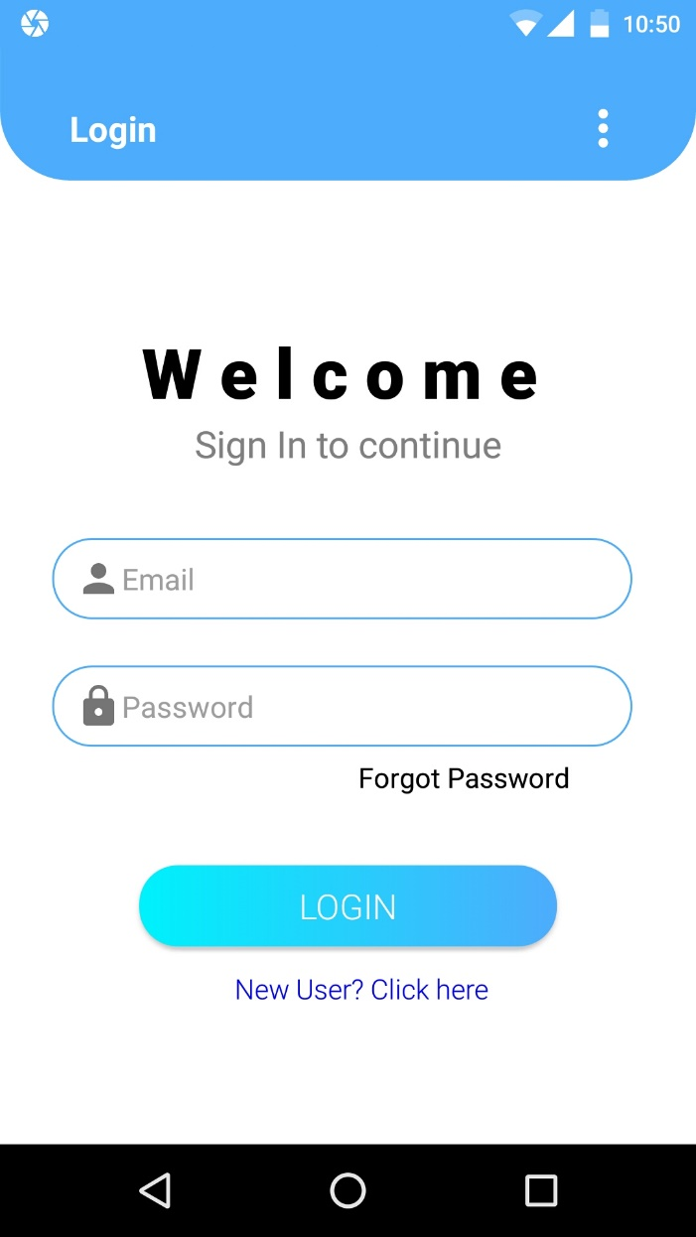
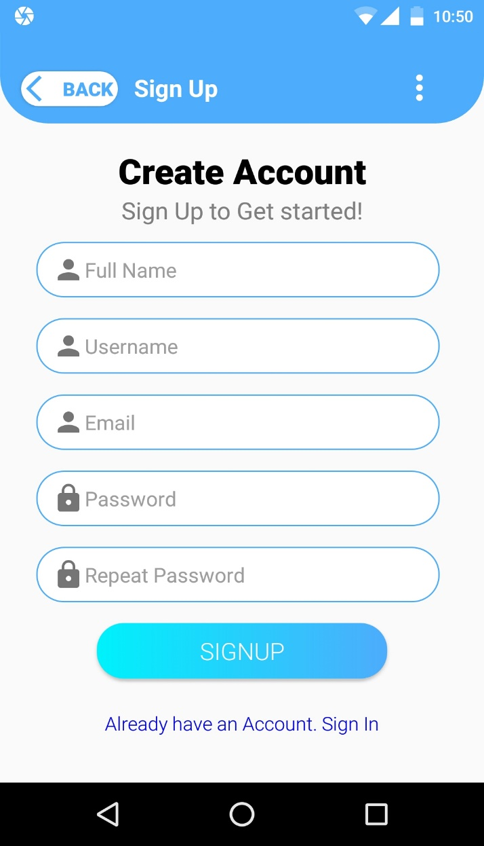
Login And Signup
_______________________________

Slide 6
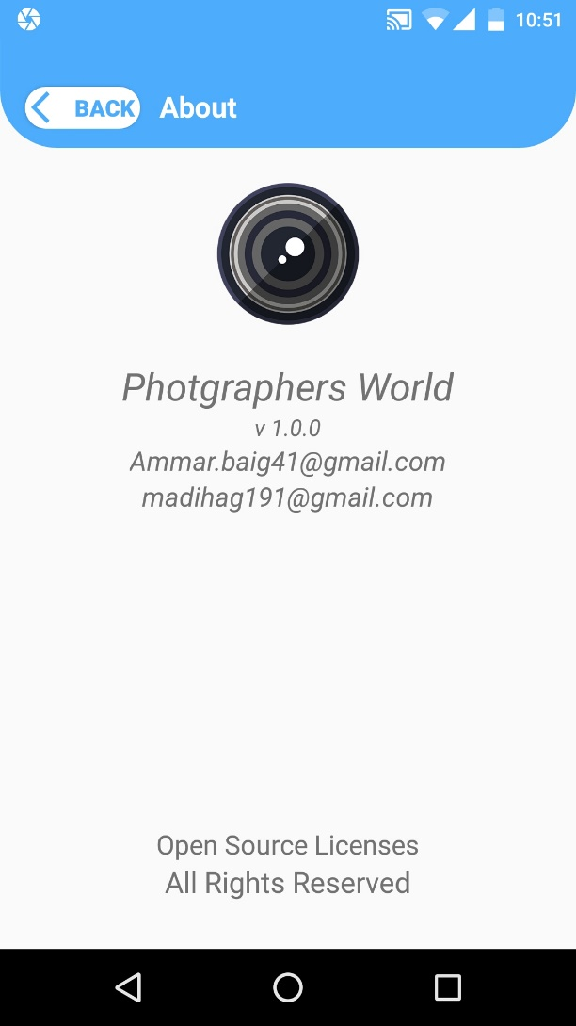
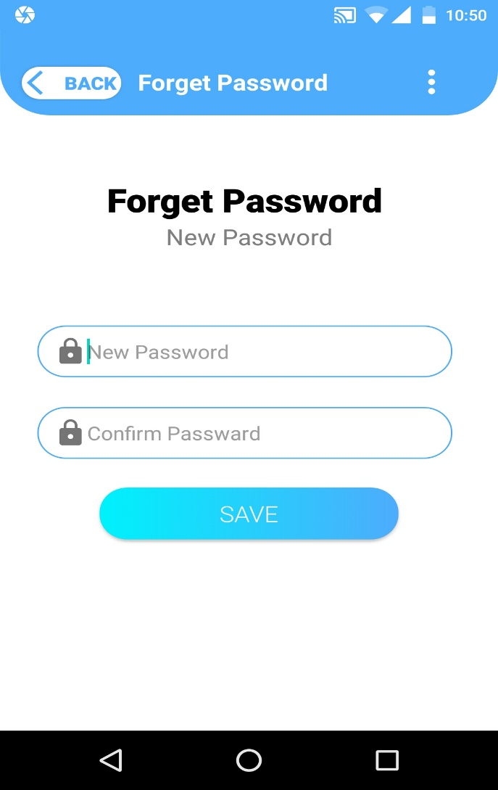
About and Forget Password
_______________________________

Slide 7
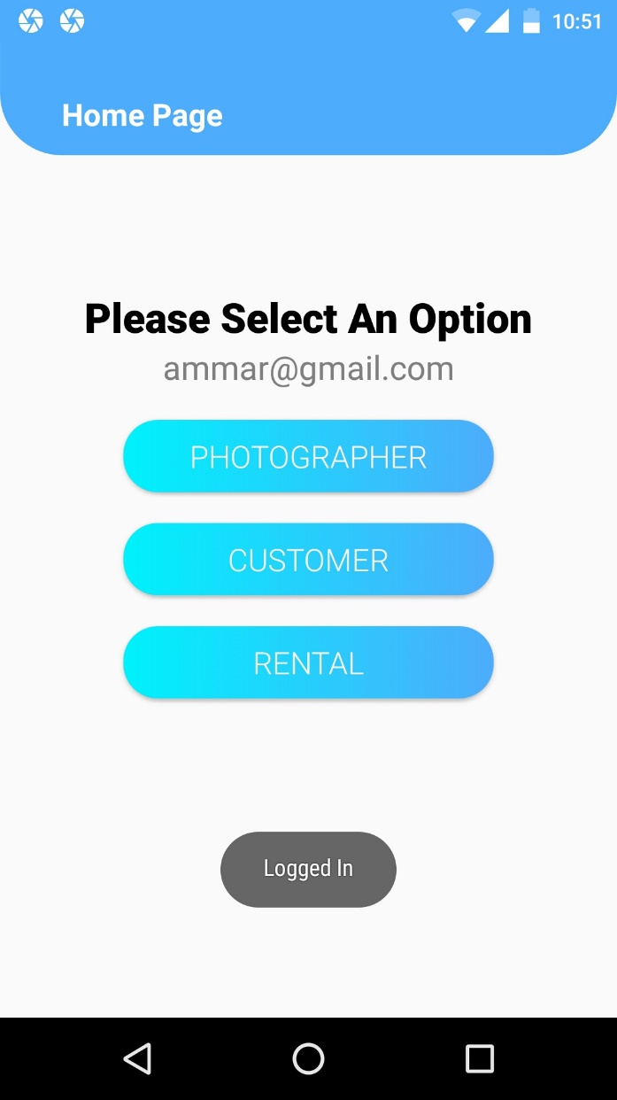
Home Page
User can either choose to be a:
Photographer
Customer
Rental
_______________________________

Slide 8
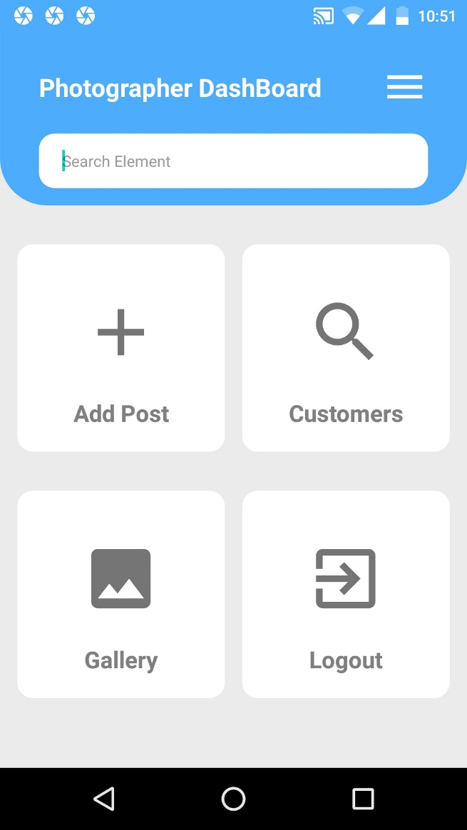
Photographers Dashboard
_______________________________

Slide 9
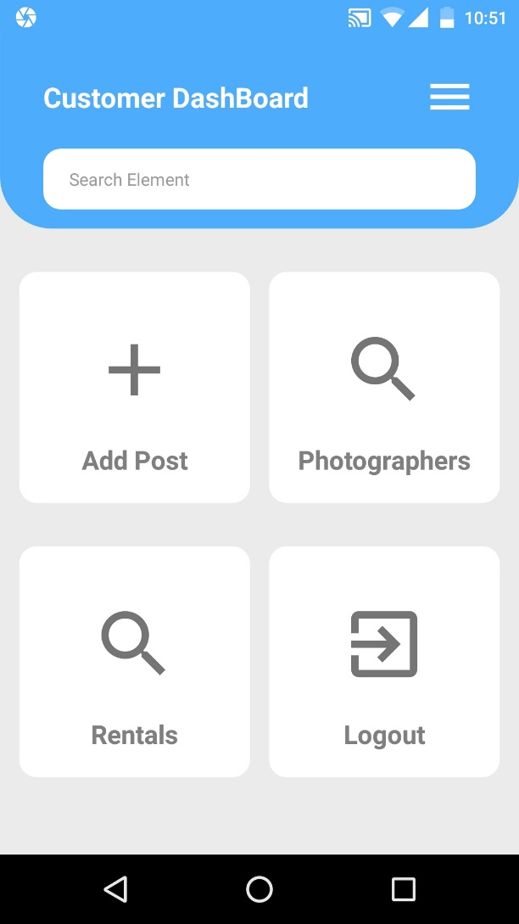
Customer Dashboard
_______________________________

Slide 10
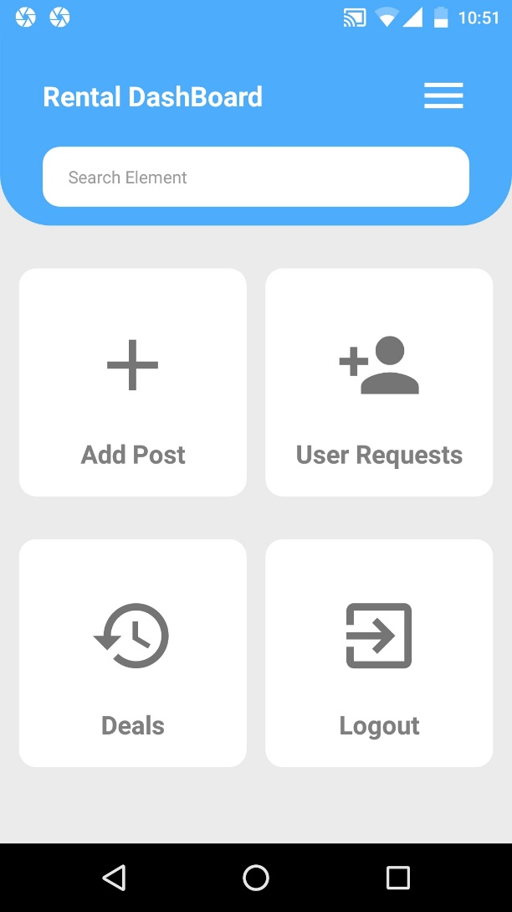
Rental Dashboard
_______________________________

Slide 11
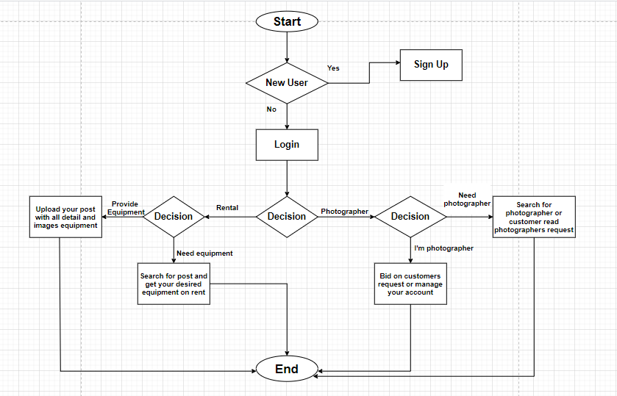
Working Flow

Slide 12
Related Work / Applications
Photographers On-Demand | Our Application(Photographers World)
You can register as a photographer or customer but not from the same account | You can register as a photographer or customer or rental from the same account
Only customer hire photographer | Customer can hire a photographer as well as photographer can hire photographers
Customer cannot create his/her request | Customer can create his/her request and many photographer Bid on it
Not verification on signup | Verification of user on signup using OTP

Slide 13
Related Work / Applications (Cont.…)
Customer Location will not show | Customer/photographer Location will be shown
No Rentals | Customer can get different equipment on rent
 | Workplace location will be show
 | Everyone can see each other profile except admin
 | Can be login with own made account, Gmail, etc.

Slide 14
Problem statement
There is very difficult to find the best photographer for your event in your town.
Some photographers have very impressive photography skills but due to lack of money, they can’t afford Photo Studio for themselves.
There is very difficult to find a photographer outside your hometown.
Many people had equipment lying around because they can’t manage to find customers to provide their equipment on rent.
People hire photographers without knowing about their skills, so the result doesn’t satisfy customers.
_______________________________

Slide 15
Objectives
This project aims to provide an android based application for the general public (customer), rentals and photographers.
They don’t waste their time to find work.
Customers can easily hire a photographer that is near his/her location or can generate his/her request according to different requirements.
Photographers also find work easily by assuring the quality of work to the customer.
Rentals can also find different customers easily on this app to provide his/her equipment on rent.
_______________________________

Slide 16
Methodology
Customers, Photographers and rentals with sign-up pages.
Photographers must mention their skills.
Admin approve account when they sign up.
Customer interface has customer’s event requirement which photographer can see and request for work.
Customer interface has also photographers which customer can see and request to hire photographers.
Customer interface has also rentals which customer can see and request to get equipment on rent.
_______________________________

Slide 17
Methodology (Cont.…)
Customers interface has Activity Log in which he/she can see the previous history and recent submitted requests.
Photographer interface has customer’s event request in which he/she can Bid on it.
Photographer interface has Add Post option in which he/she can add different post.
Photographer interface has Gallery option in which he/she can manages images according to categories.
Photographer interface has Portfolio option in which he/she can manage his portfolio.
_______________________________

Slide 18
Methodology (Cont.…)
Rentals interface has Add Post option in which he/she can add post to give equipment on rent.
Rentals interface has Requests option in which he/she can see the requests from the customer who are willing to get equipment on rent.
Rentals interface has Deals option in which he/she can see which user has his equipment on rent.
_______________________________

Slide 19
Modern Tools
Software Requirements dependence:
IDE: Android Studio
Programming language: Java, XML
Database: Firebase
Tools: Android Studio
JDK
SDK
MS Word (Documentation)
MS Power Point (Presentation Work)
Hardware Requirements dependence:
Smart Mobile Phone: Android Studio

Slide 20
Benefits
Customer can easily find photographer near his/her location.
Customer can easily find different equipment on rent.
Photographers can easily find work and earn.
The time of customer and photographer can be saved easily.
Rentals can easily find customers to give equipment on rent.
_______________________________

Slide 21
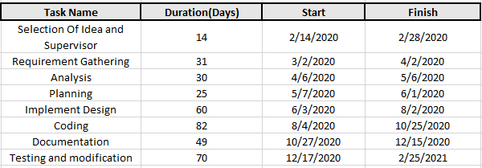
Timeline
_______________________________

Slide 22
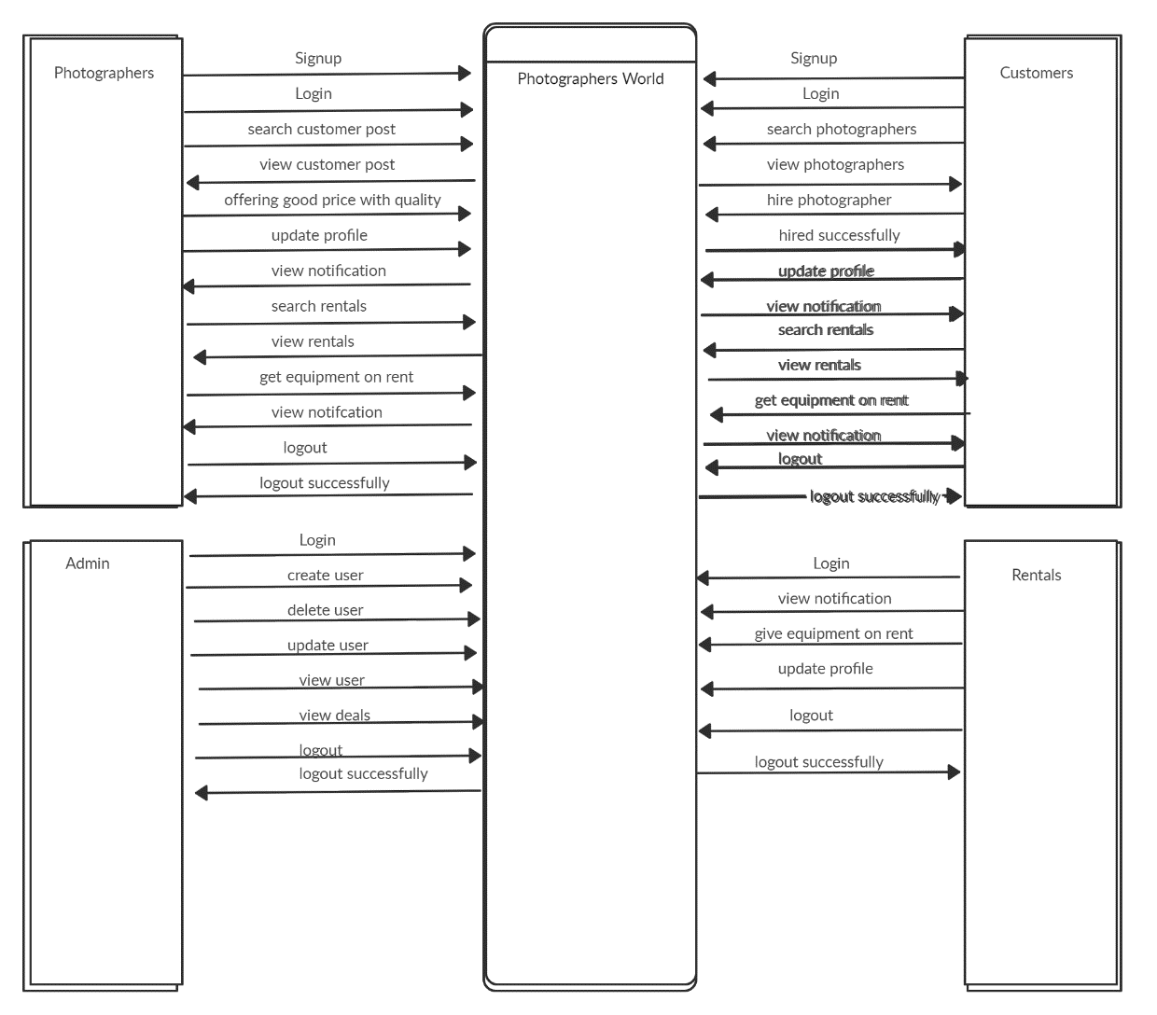
Data Flow Diagram
_______________________________

Slide 23
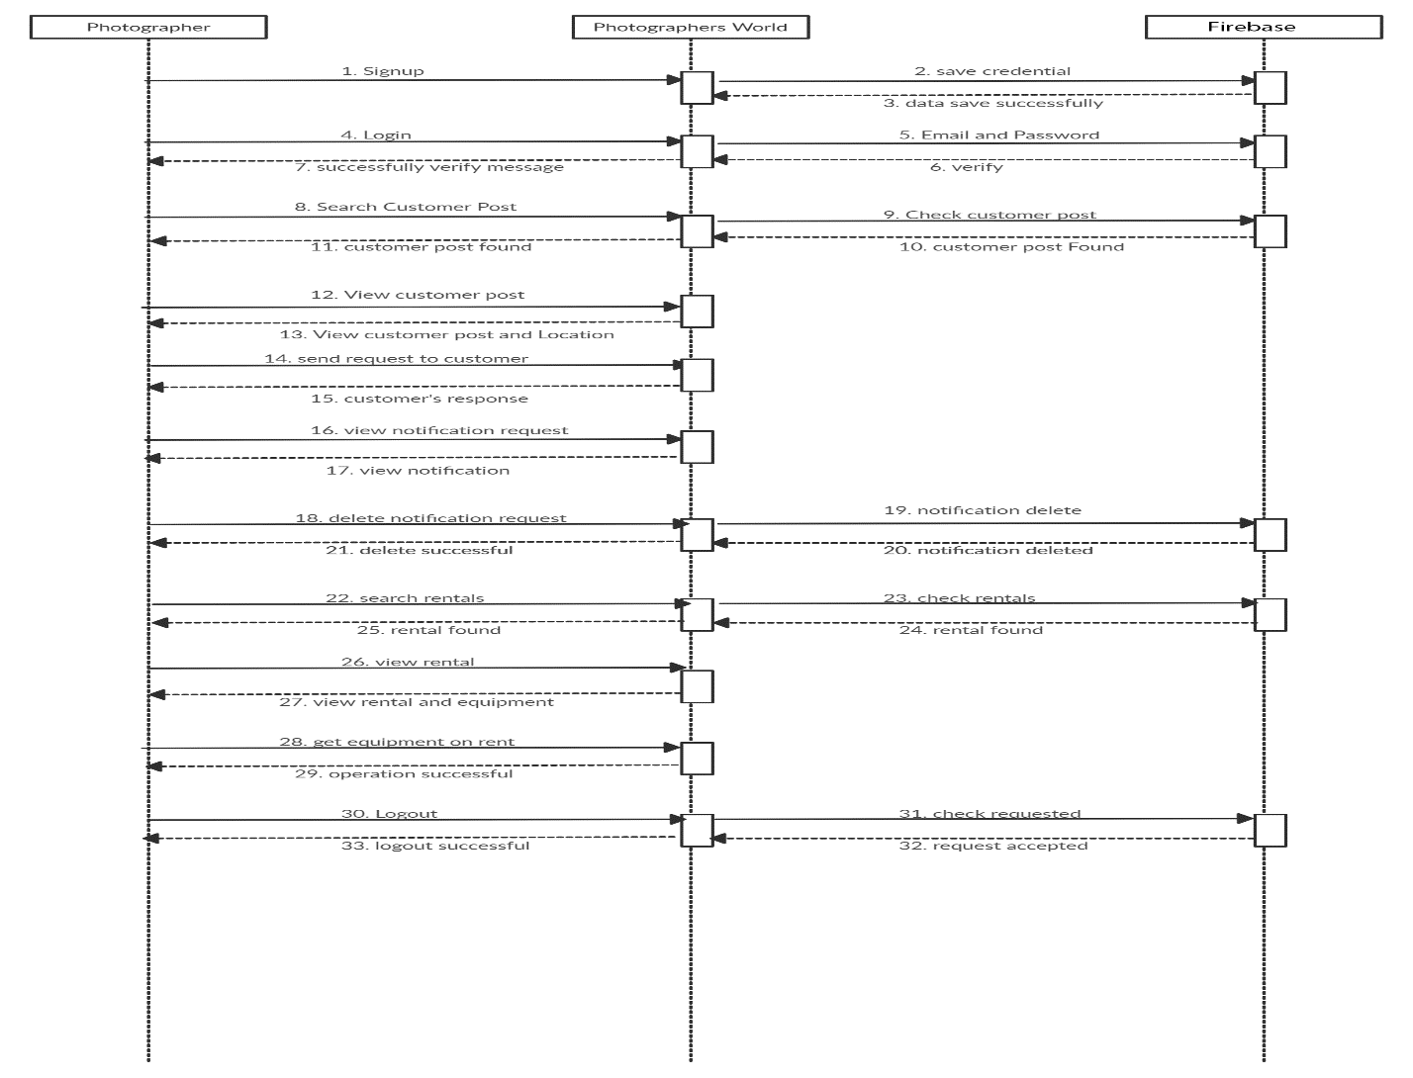
Photographer Sequence Diagram
_______________________________

Slide 24
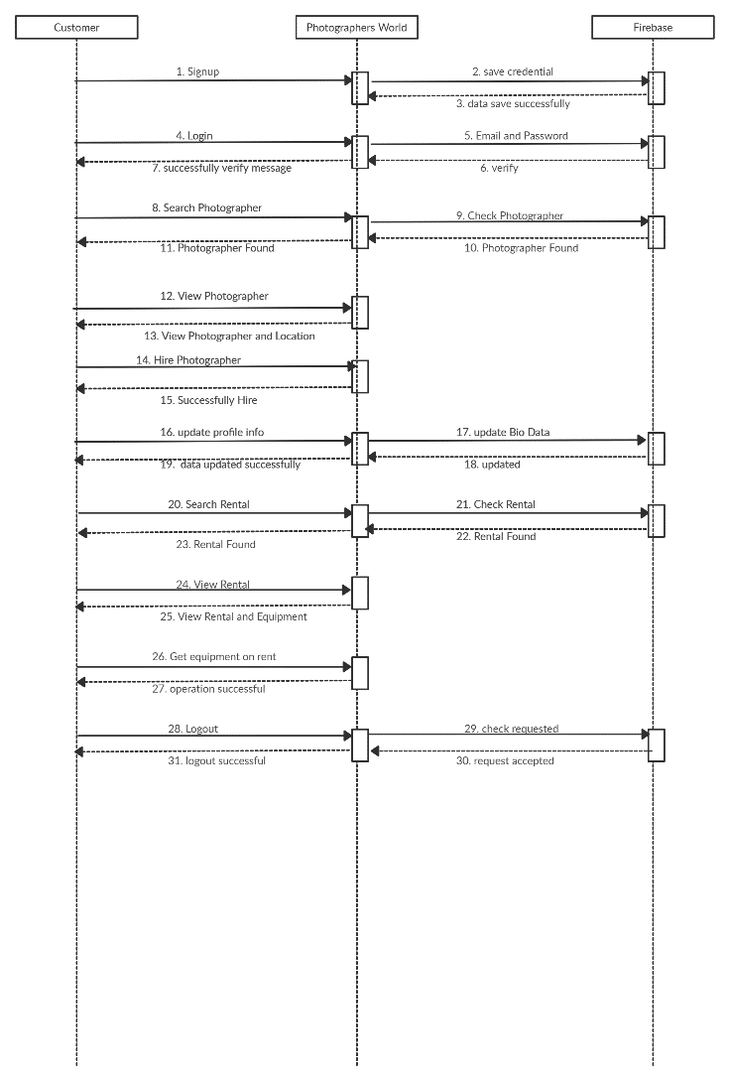
Customer Sequence Diagram
_______________________________

Slide 25
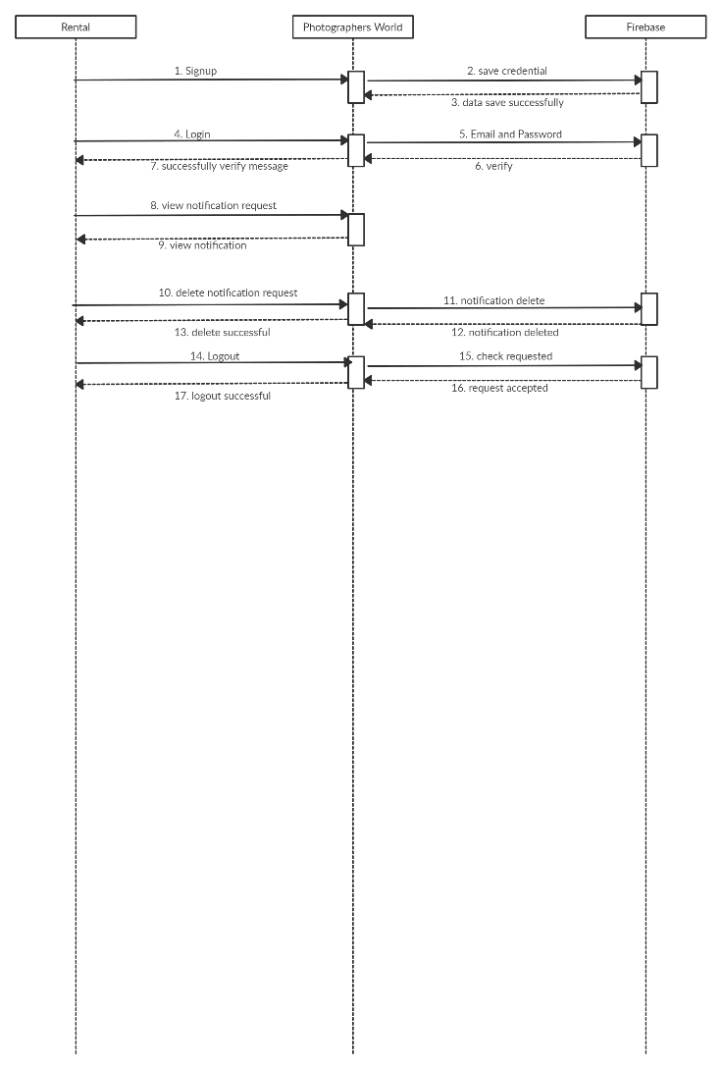
Rental Sequence Diagram
_______________________________

Slide 26
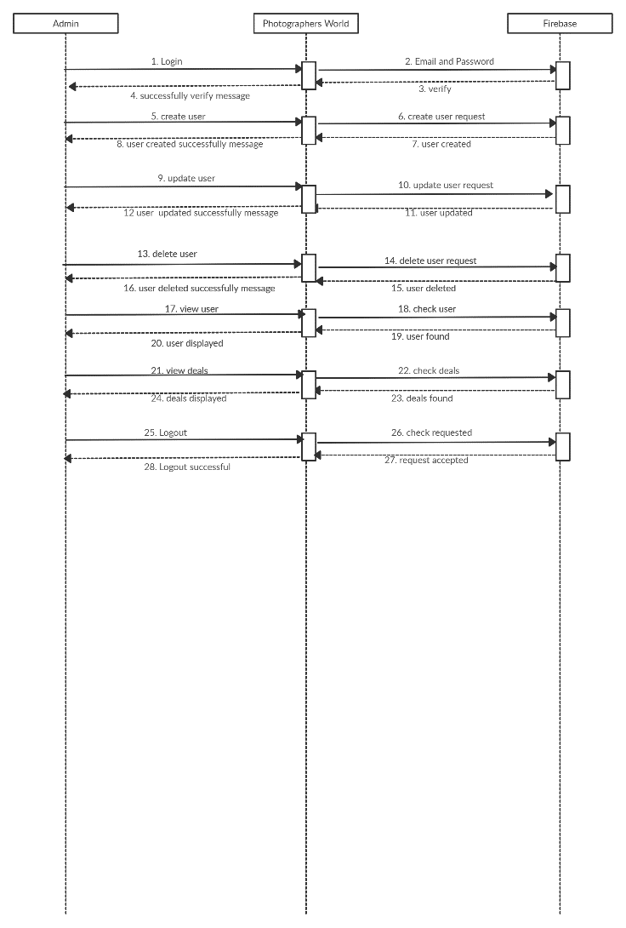
Admin Sequence Diagram
_______________________________

Slide 27
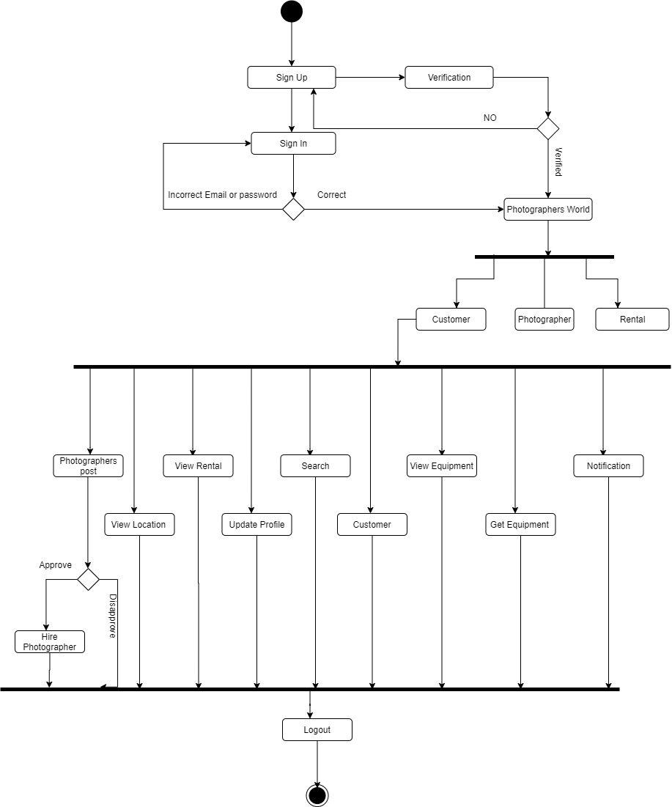
Customer Activity Diagram
_______________________________

Slide 28
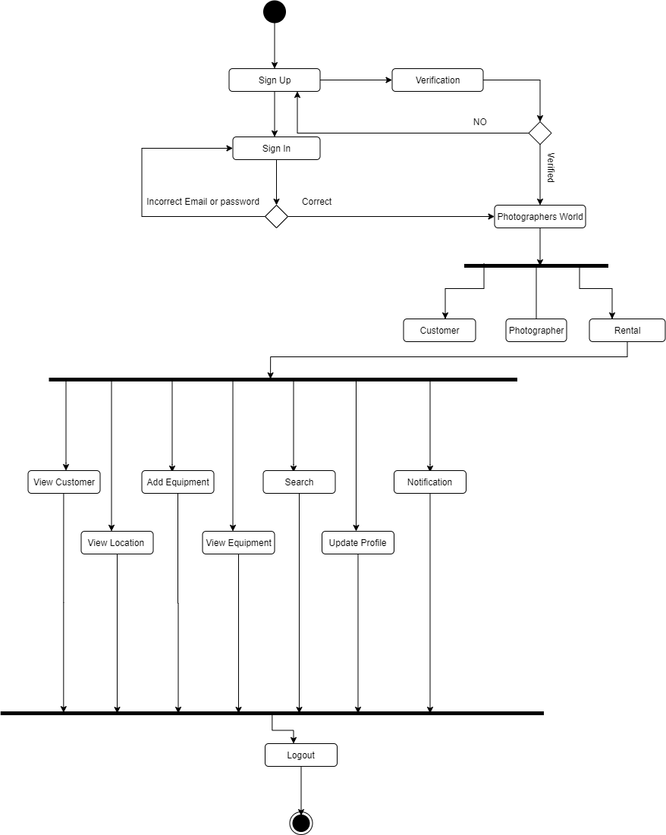
Rental Activity Diagram
_______________________________

Slide 29
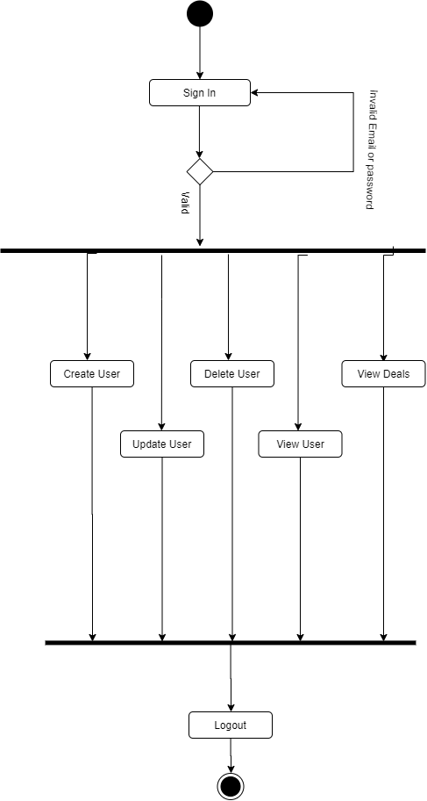
Admin Activity Diagram
_______________________________

Slide 30
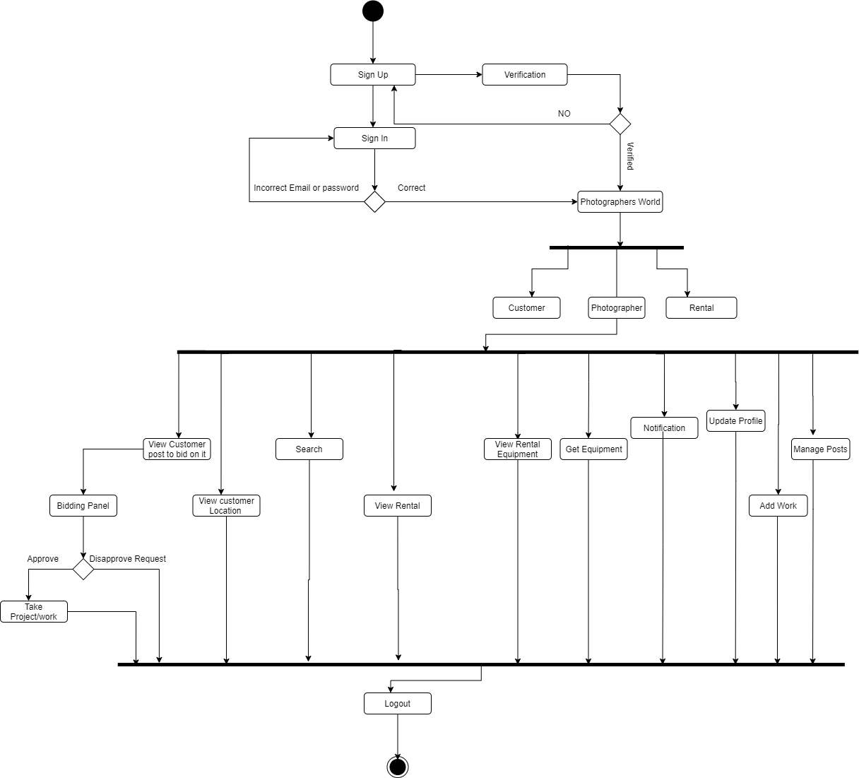
Photographer Activity Diagram
_______________________________

Slide 31
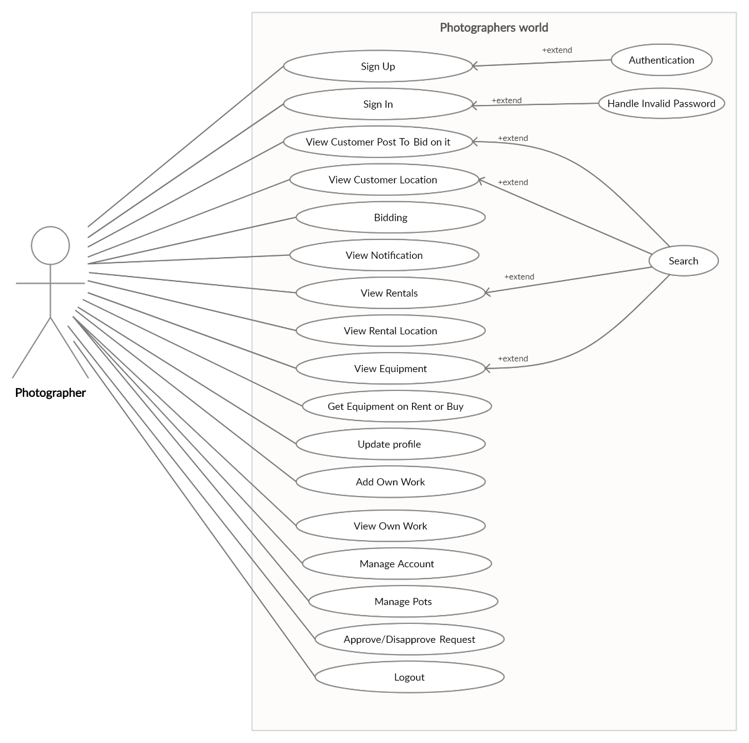
Photographer Use Case
_______________________________

Slide 32
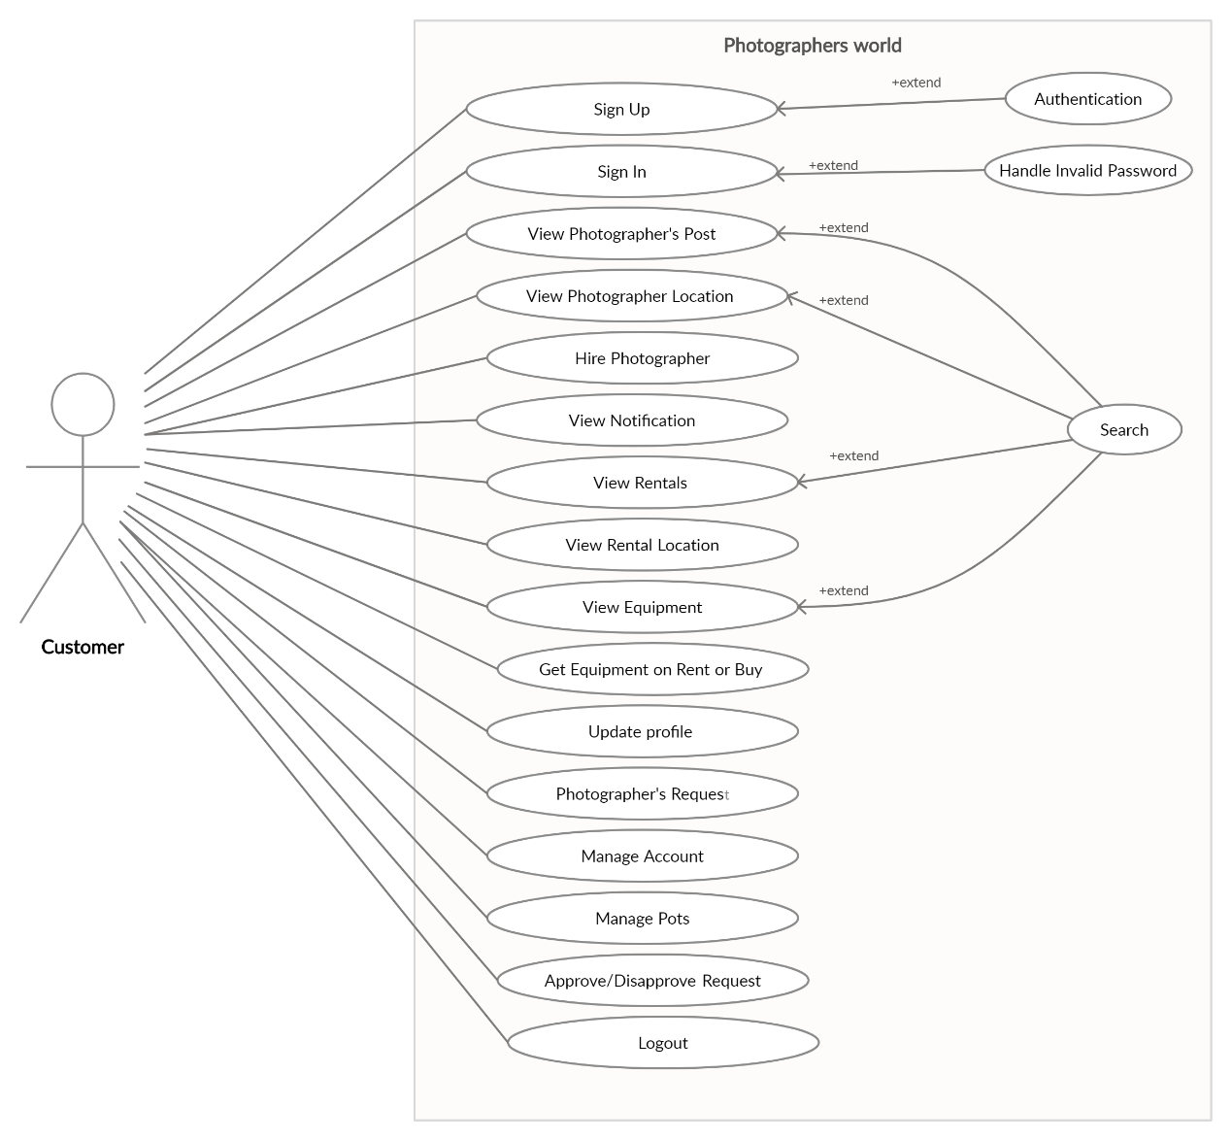
Customer Use Case
_______________________________

Slide 33
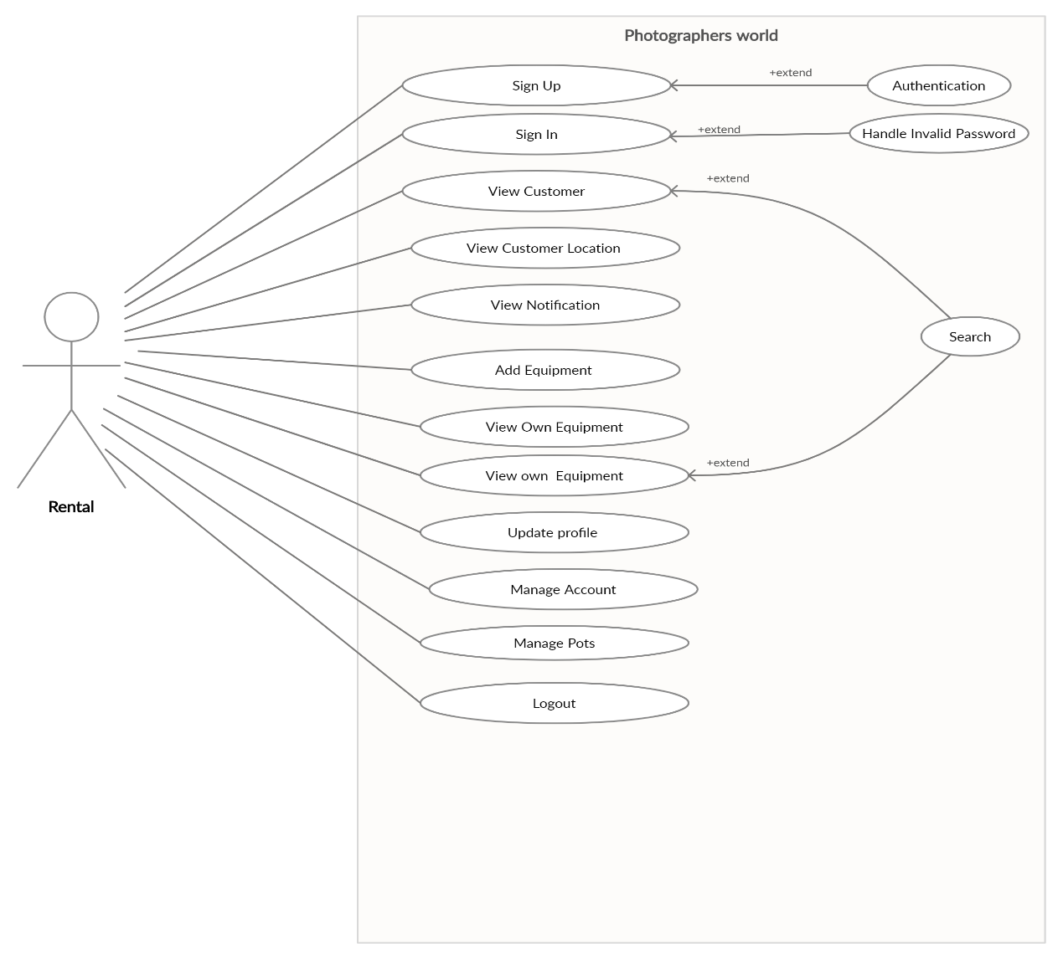
Rental Use Case
_______________________________

Slide 34
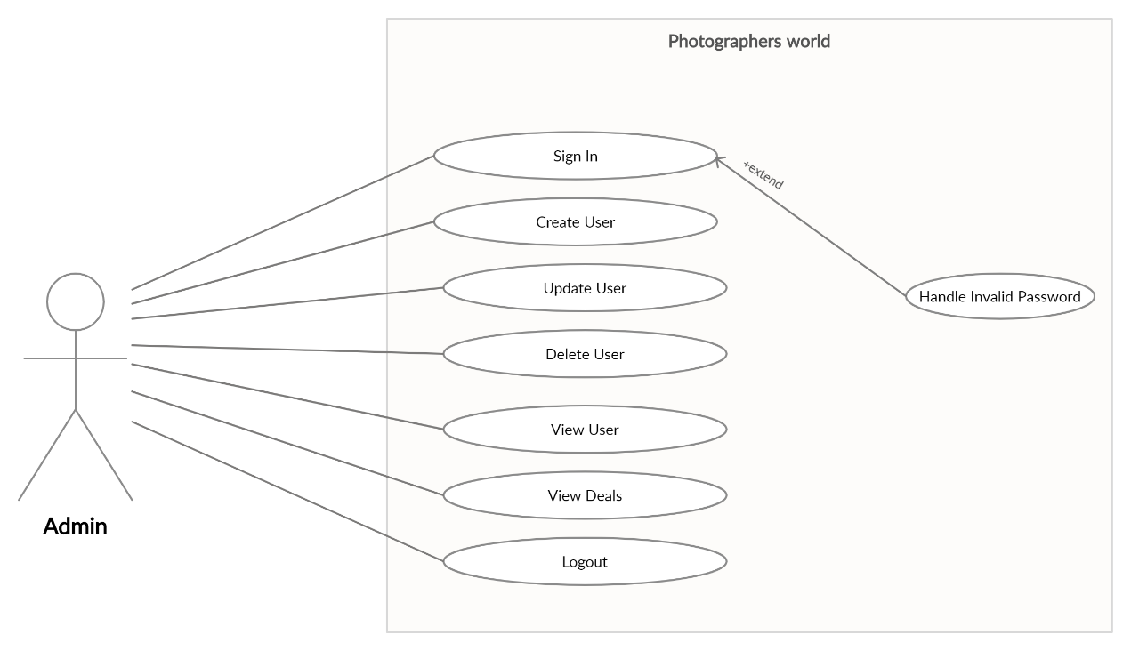
Admin Use Case
_______________________________

Slide 35
References
https://en.wikipedia.org/wiki/Android_software_development
https://developer.android.com/studio/workflow
https://www.techotopia.com/Designing_a_User_Interface_using_the_Android_Studio_Designer_Tool
https://www.infoworld.com/article/3104621/android-studio-for-beginners-part-2-explore-and-code-the-app.html
_______________________________

